Slide 1
Maryland NextGen Testbank: Pediatric Mini Review

Slide 2
NextGen Test Bank Disclosures
This review uses items in the Maryland NextGen Test Bank accessed with a Qualtrics link or QR Code.
The Maryland Testbank contains peer-reviewed items written by faculty across the State of Maryland that attempt to align with publicly available information about Next Generation NCLEX.
The Maryland NextGen Test Bank Project was funded by the Maryland Nursing Workforce Center as part of a grant from the Maryland Higher Education Commission Nurse Support Program II # 20-125.
This review will take approximately 1.5 to 2 hours to complete.
For best result, use a laptop, notebook, or desktop to answer the questions.

Slide 3
About The NextGen NCLEX
Starting April 1, 2023, graduates will take an updated version of the National Council Licensure Exam referred to as Next Generation NCLEX.
Next Generation NCLEX (NGN) will continue to test a candidate’s ability to provide safe client care while incorporating new methods to better test clinical judgment.
The testing methods will include using new item response types in clinical judgment case studies and stand-alone questions to test the NCSBN Clinical Judgment Measurement Model(NCJMM) (https://www.ncsbn.org/exams/next-generation-nclex/NGN+Resources/clinical-judgment-measurement-model.page)

Slide 4
The Five New Item Response Types
Extended multiple response items with increased answer options.
Drag-and-drop items that involve moving options to placeholders.
Drop-down items where candidates select the missing words from sentences, paragraphs, or tables.
Highlight items that require candidates to identify parts of the medical record to answer questions.
Matrix/grid items that involve completing tables of information.

Slide 5
Case Studies
Unfolding case studies use approved NGN item types to answer questions about evolving real-world nursing scenarios.
Case studies present 6 linked questions to test the 6 steps of the NCJMM in order:
Recognize cues
Analyze cues
Prioritize hypotheses
Generate solutions
Take action
Evaluate outcomes
Candidates should expect to complete 3 to 5 case studies in a minimum length 85 question NCLEX exam.

Slide 6
Stand-alone Item Types
Stand-alone (single) items test either client needs or clinical judgment
Client needs items test knowledge of the 8 client needs using traditional or new item types.
Clinical judgment items present information in a clinical scenario specifically targeting one or more NCJMM clinical judgment step.
There are 2 unique types of clinical judgment stand-alone items:
Bowtie
Trend
Clinical judgment stand-alone items make up approximately 10% of stand-alone items.

Slide 7
Stand-alone Item: Bowtie
A bowtie is a drag-and-drop response item variation.
After reading a clinical scenario, candidates move response options (tokens) to placeholders (targets).
On NCLEX the placeholders are arranged in the shape of a bowtie.
Candidates must select:
1 condition the client is most likely experiencing from 4 options.
2 actions to take to address the condition from 5 options.
2 parameters to monitor the client’s progress from 5 options.

Slide 8
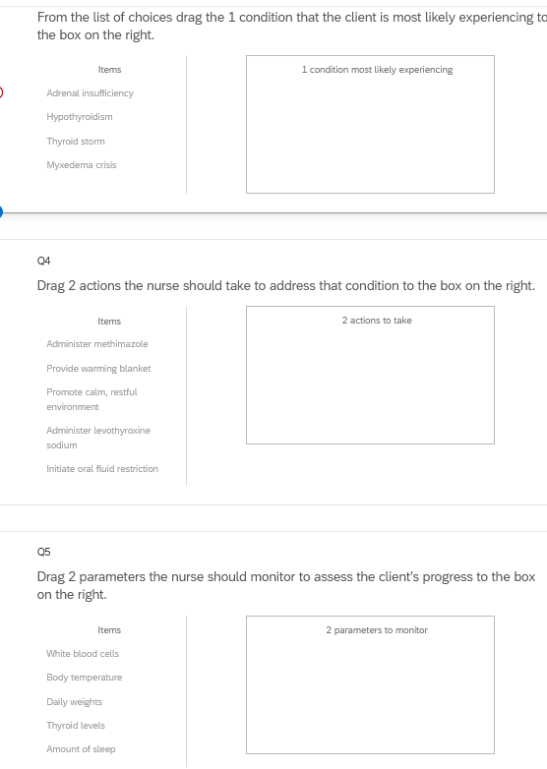
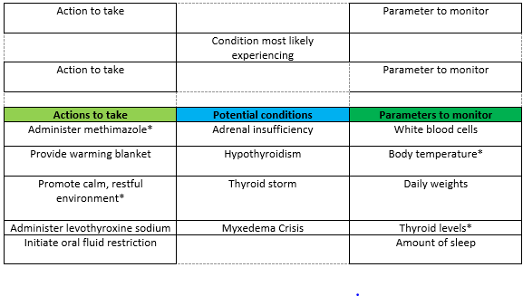
Bowties in Qualtrics
Bowties in Qualtrics are 3 drop and drag question- but they don’t make a “bowtie” shape.

Slide 9
Stand-alone Item: Trends
Trend items require the candidate to make clinical judgments based on client data presented at different time points.
Trend items may address one or more clinical judgment steps but do not follow the six-item sequence like case studies do.
Trend items can feature any item response type except bowtie.

Slide 10
About This Review
Your instructor will provide a QR code or link to answer a series of case studies, bowtie items and trends across a lifespan
While questions throughout the test bank use all 5 new item response, not all specific variations that might be used on NCLEX are not included such as drop-down items formatted as a table.
Information needed to answer questions will be displayed in a medical record, but the medical record will display differently on the actual NCLEX.
To see how items will exactly appear on NCLEX see tutorials at https://nclex.com/next-generation-nclex.page

Slide 11
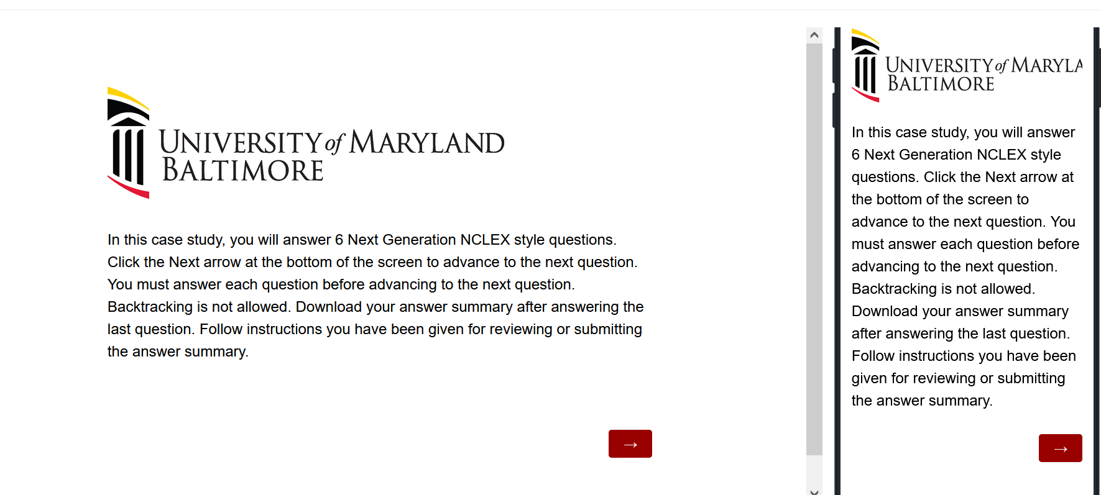
The First Screen Provides Instructions
Use the arrow to advance the screens
There is no backtracking

Slide 12
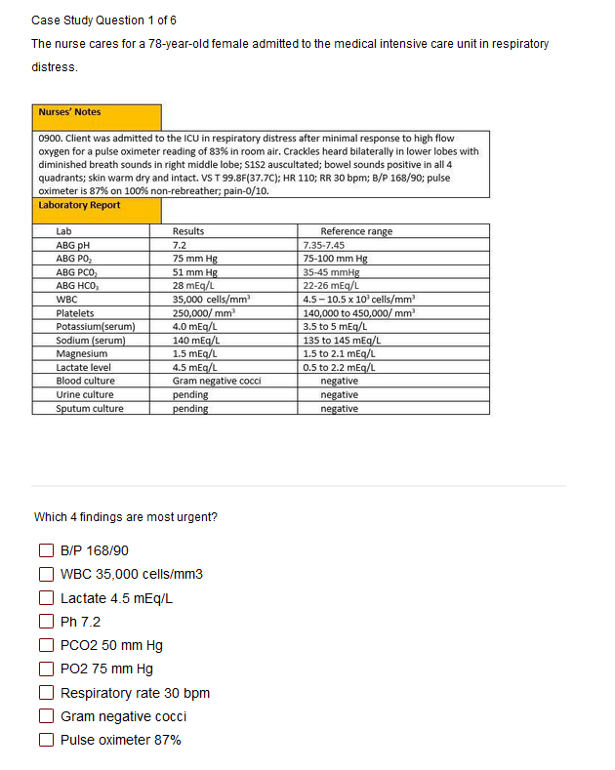

Answer the Questions
Read the instructions carefully.
Sometimes the question tells how many options to pick.
Other times you select all that apply.
Some questions will not allow you to advance if they have not answered enough options.
Use the arrow to advance to the next question if doing a case study

Slide 13
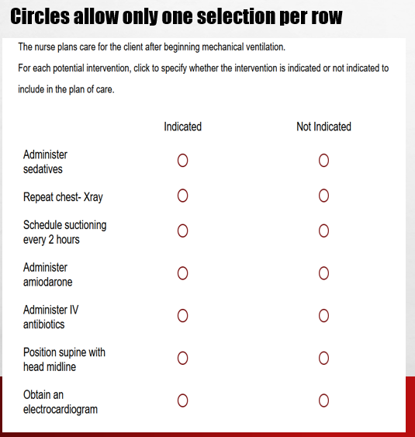
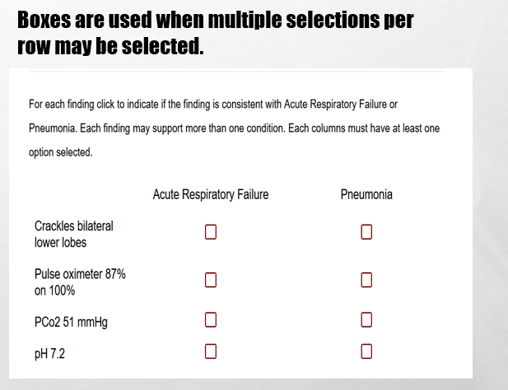
In Tables, Follow Instructions for How Many Options May be Selected in a Row.

Slide 14
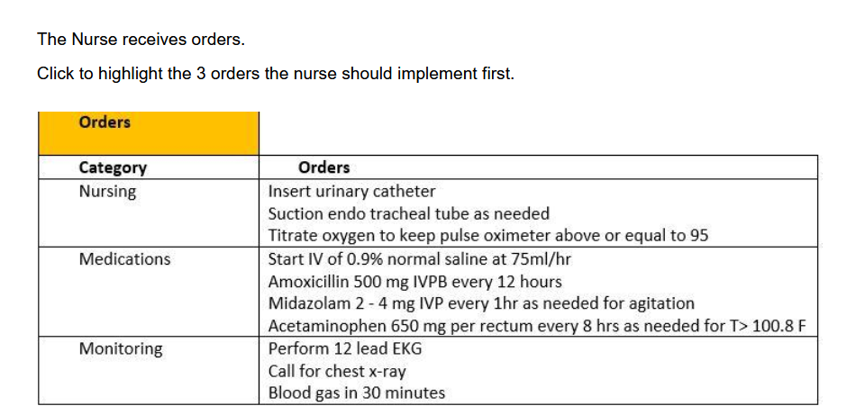
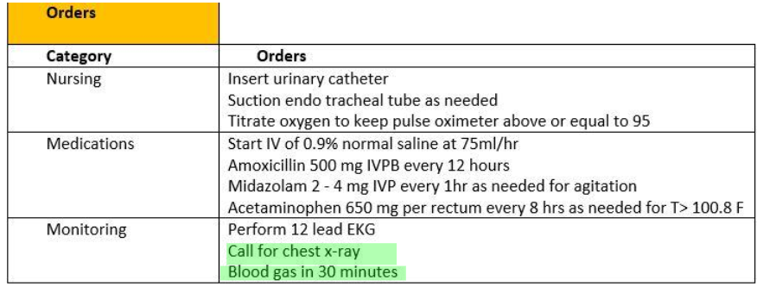
Highlight Questions
Questions first show a plain EMR page
Hovering curser makes boxes appear around selectable data
Click the box to apply the highlight; A second click removes it.

Slide 15
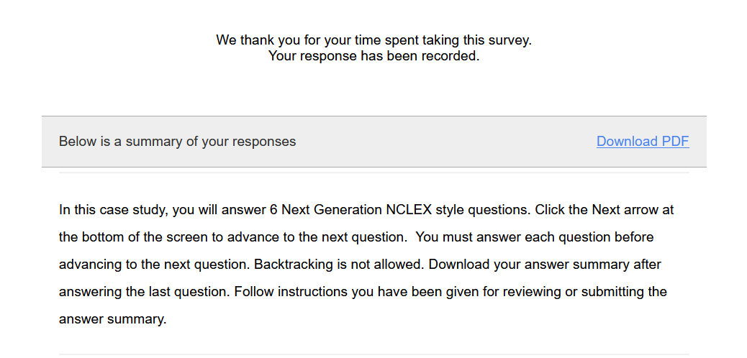
Submit the Final Question and Click Download PDF from Thank You Screen
It is the only way to save your answers.
This step is critical!

Slide 16
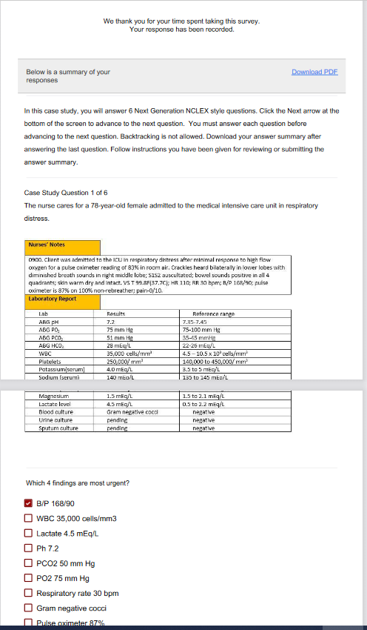
The Response Summary Shows Your Answers
Follow your faculty’s instructions for saving the response summary.
They may have you print it out, save it to computer, or upload it to a learning management system.
The response summary DOES NOT give you the correct answers.
Answers will appear on subsequent slides with information on how to score the item and a rationale for the answer.

Slide 17
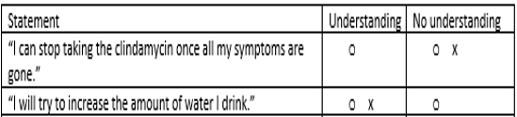
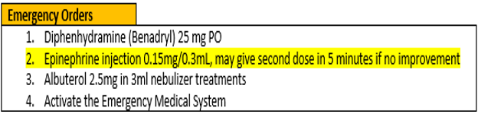
Correct Answers
Correct answers may be indicated 1 of 4 ways
Asterisk appears after correct option*
Option may be underlined with or without an *
Option may appear as an X or * in a table
Correct answer may appear as highlight

Slide 18
New Scoring Rule: +/-
Used when takers may pick unlimited options
Possible points are number of keyed correct items
Earn 1 point for each correct item selected
Loose 1 point for each incorrect item selected
Guessing penalty prevents takers from gaming system by selecting all
Minimum score =0
Which items are viruses? Select all that apply.
■ Chlamydia
■ Influenza[✓]
■ Hepatitis B [✓]
Lyme disease
Pertussis
Tuberculosis
Varicella [✓]
+/- Scoring rule
3 points possible
+2 correct
-1 incorrect
-----------------
1 points

Slide 19
New Scoring Rule: 0/1
Used when takers may select limited options
Possible points are number of keyed correct items
Earn 1 point for each correct item selected
Earn 0 points for incorrect responses
Minimum score 0
Which 3 items are viruses?
■ Chlamydia
■ Influenza[✓]
■ Hepatitis B [✓]
Lyme disease
Pertussis
Tuberculosis
Varicella [✓]
0/1 Scoring rule
3 points possible
+2 correct
-----------------
2 points

Slide 20
Same Answers: Different Scores
Select all that apply
Which 3 items are viruses?
■ Chlamydia
■ Influenza[✓]
■ Hepatitis B [✓]
Lyme disease
Pertussis
Tuberculosis
Varicella [✓]
Which items are viruses? Select all that apply
■ Chlamydia
■ Influenza[✓]
■ Hepatitis B [✓]
Lyme disease
Pertussis
Tuberculosis
Varicella [✓]
0/1 Scoring rule
3 points possible
+2 correct
-----------------
2 points
+/- Scoring rule
3 points possible
+2 correct
-1 incorrect
-----------------
1 point

Slide 21
Rationale Scoring Rule
Complete the sentence from list of dropdown options.
To prevent night blindness the nurse would recommend
because they are rich in vitamin
Used when question has linked concept and a justification in the same sentence
Example: The client most likely has an asthma exacerbation as evidenced by the breath sounds.
Dyad worth 1 point
One cause and one effect
Both parts must be correct for credit
Triad worth 2 points
One cause 2 effects
Cause must be right for any credit
Partial credit given (1 point) if only 1 effect is correct
almonds
carrots✓
orange juice
A
B
C✗
Right condition,
Wrong justification =0 points

Slide 22
Keep track of your score as you move through the review
Case study | My score
Case study 1
Bowtie 1
Case study 2
Bowtie 2
Case study 3
Trend 1
Total Points

Slide 23
Final Link
The final link in the review takes you to the course evaluation.
This anonymous information will be used to help us understand how this review is being used and how to improve the experience.

Slide 24
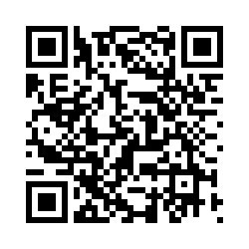
Case Study # 1
URL
QR Code
https://umaryland.az1.qualtrics.com/jfe/form/SV_8cQvohVkmgfi6Wy
Take about 10 minutes

Slide 25
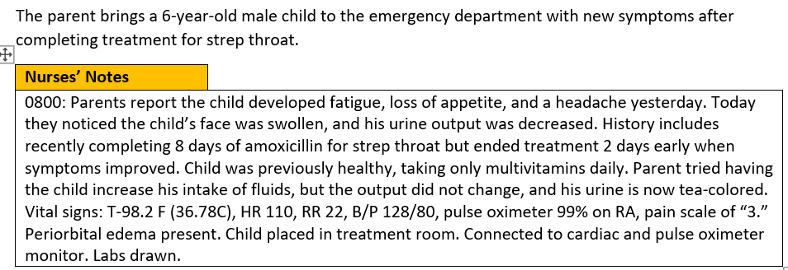
Screen 1 of 6
Drag the 4 findings are most significant to the box on the right
Client Findings
Blood pressure*
Periorbital edema*
Poor appetite
Headache
Fatigue
Urine output*
Increased intake of fluids
History of strep throat*
0/1. This question is worth 4 points.
Give yourself 1 point for each correct response.

Slide 26
Rationale
The blood pressure for an 8- year-old should be less than 120/80. The history of recent strep throat, blood pressure, periorbital edema and changes in urine output are the most significant findings because they suggest the child has poststreptococcal glomerulonephritis. The child is at risk for heart failure, seizures, and encephalopathy due to hypertension and fluid overload as evidenced by bilateral periorbital edema, decreased urine output, hematuria, and high blood pressure of 128/80.

Slide 27
Screen 2 of 6
The nurse suspects poststreptococcal glomerulonephritis and considers the child’s risks.
Which of the following complications is the client at risk for experiencing? Select all that apply
Bowel obstruction
Heart failure*
Diabetes
Liver failure
Fluid overload*
Acute renal failure*
Adrenal insufficiency
Hypertension*
+/-. This question is worth 4 points.
Give yourself 1 point for each correct response
AND subtract 1 point for each incorrect response you select. The least you can score is 0.

Slide 28
Rationale
The child is at risk for fluid overload leading to hypertension and cardio- pulmonary congestion leading to heart failure. Untreated the decreased urine output, hematuria, and high blood pressure can lead to renal failure. Gastrointestinal, endocrine, and hepatic complications are not known ramifications of poststreptococcal glomerulonephritis.

Slide 29
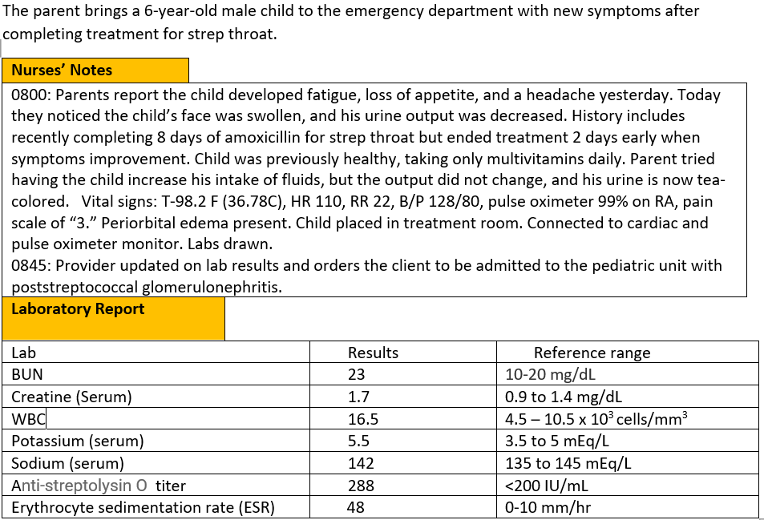
Screen 3 of 6
Labs return and the child receives the diagnosis of poststreptococcal glomerulonephritis.
Complete the sentence from the list of drop-down options.
The problem the nurse needs to address first is | treating the infection lowering the blood pressure managing the fluid overload*
0/1. This question is worth 1 point.
Give yourself 1 point if you answered correctly.

Slide 30
Rationale
The top priority is to manage the fluid overload. Managing the overload will help the blood pressure. The nurse will anticipate orders to treat the infection, however the problem is being caused by an immune response not an infection.

Slide 31
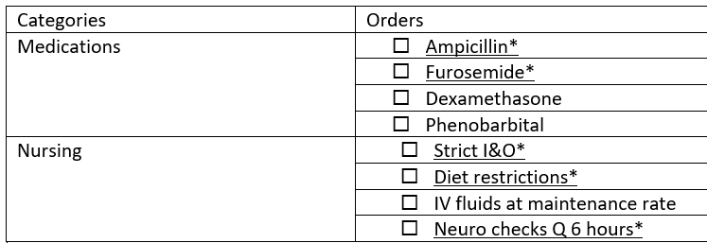
Screen 4 of 6
Select the orders from each of the categories the nurse should anticipate including in the plan of care. Each category may have more than one order.
+/-. This item is worth 5 points- Score each category separately first and then add scores together.. Score 1 point for each correct answer AND subtract 1point for each incorrect answer. The worst you can score is 0 per category.
Medications = 2 points
Nursing= 3 points

Slide 32
Rationale
The child is experiencing poststreptococcal glomerulonephritis. Treatment will include antibiotics for positive Group A streptococcal infection and diuretic therapy for fluid overload and hypertension. Antihypertensives will be added as needed. Other treatment will include strict I&O, sodium and fluid restrictions, and neuro checks every 6 hours due to risk of development of seizures and encephalopathy.

Slide 33
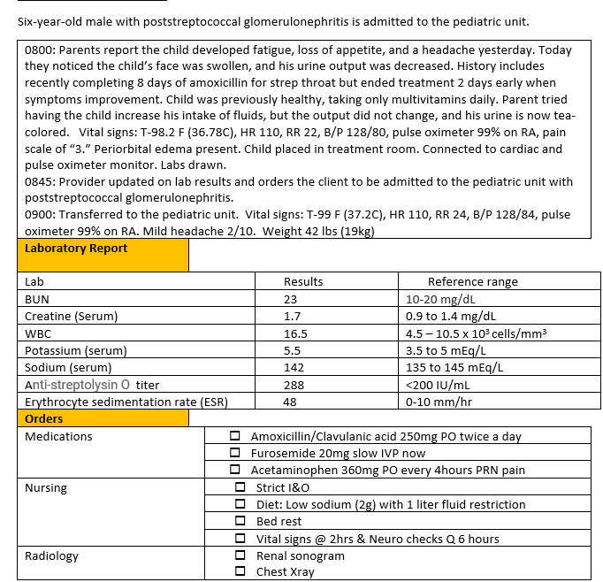
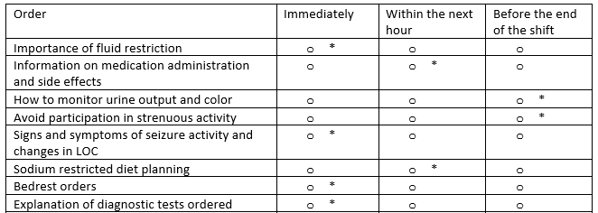
Screen 5 of 6
The The nurse plans the family teaching about the treatment plan.
For each teaching point, click to specify if the nurse should address the teaching immediately upon admission, within the next hour, or before the end of the shift.
0/1. This item is worth 8 points. Give yourself 1 point for every row you got right.

Slide 34
Rationale
When teaching is complex, teaching should be broken down into short segments. Upon admission the things that are most important for the nurse to address before leaving the client alone are the bedrest and fluid restriction orders, signs and symptoms to call the nurse for (in this case seizures or changes in LOC) and diagnostic test that are ordered so the client will not be surprised if another team member comes into the room. Medication teaching should be done when the medicine is given. Diet teaching will need to be done before lunch. Since the client is on bedrest discussions of strenuous activities can occur later. Discussions of monitoring urine output can occur when the child needs to void.

Slide 35
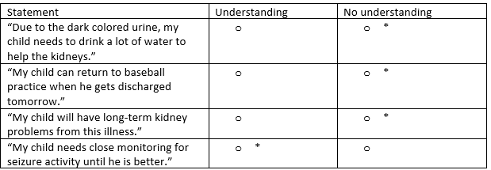
Screen 6 of 6
The nurse evaluates the family’s understanding of the treatment plan.
For each client statement, click to specify whether the statement indicates an understanding, or no understanding of teaching provided.
0/1. This item is worth 4 points. Give yourself 1 point for every row you got right.

Slide 36
Rationale
The child is experiencing poststreptococcal glomerulonephritis. The child is at risk for seizures and encephalopathy. The parent must understand the importance of close monitoring for changes in level of consciousness or seizure activity and when to seek additional medical attention.

Slide 37
Case Study 1 Score
Question | Possible | My score
1 | 4
2 | 4
3 | 1
4 | 5
5 | 8
6 | 4
Total | 26

Slide 38
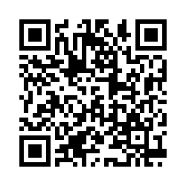
Bowtie # 1
URL
QR Code
https://umaryland.az1.qualtrics.com/jfe/form/SV_2nkk8caqQOO0gx8
Take 2-3 minutes

Slide 39
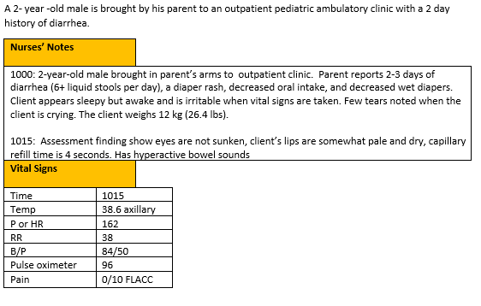
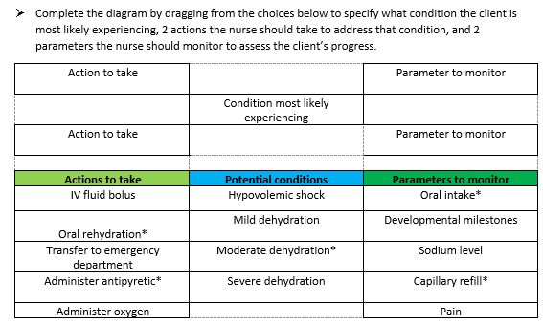
0/1. This item is worth 5 points. Give yourself 1 point for every correct selection.

Slide 40
Rationale
The child is showing signs of moderate dehydration including decreased tears, decreased urine output, pale/dry oral mucosa and irritability. He is not demonstrating hypotension or signs of shock at this time. It is the standard of care to attempt oral rehydration in an outpatient setting for moderate dehydration, but the child’s perfusion and circulation should be monitored to ensure he does not decompensate. His intake should also be closely monitored to ensure he is retaining some of the rehydration offered.

Slide 41
Bowtie 1 Score
Question | Possible | My score
Conditions | 1
Actions | 2
Parameters | 2
Total | 5

Slide 42
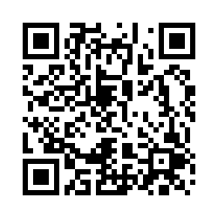
Case Study # 2
URL
QR Code
https://umaryland.az1.qualtrics.com/jfe/form/SV_7Wl1bgDCalPn6E6
Take about 10 minutes

Slide 43
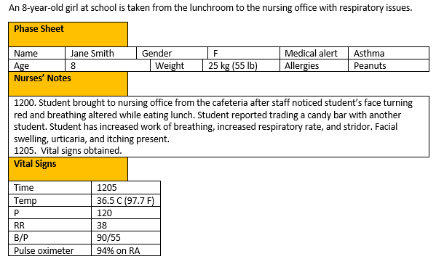
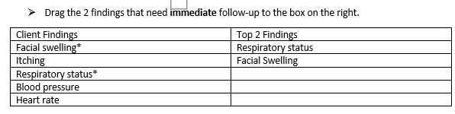
Screen 1 of 6
0/1. This question is worth 2 points.
Give yourself 1 point for each correct response.

Slide 44
Rationale
Respiratory status change is an emergent event, and facial swelling can lead to a closed airway.

Slide 45
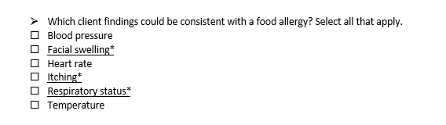
Screen 2 of 6
+/-. This question is worth 3 points.
Give yourself 1 point for each correct response
AND subtract 1 point for each incorrect response you select. The least you can score is 0.

Slide 46
Rationale
Child has a known food allergy. Asthma could account for increased work of breathing but typically wheezing is common not stridor. Airway obstruction could be a consideration due to eating lunch and potentially choking. Croup can account for the respiratory issues the child exhibits but fails to explain the hives and itching.

Slide 47
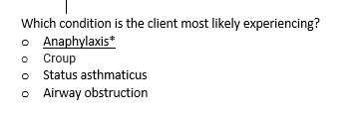
Screen 3 of 6
0/1. This question is worth 1 point.
Give yourself 1 point if you answered correctly.

Slide 48
Rationale
Child has a known food allergy. Asthma could account for increased work of breathing but typically wheezing is common not stridor. Airway obstruction could be a consideration due to eating lunch and potentially choking. Croup can account for the respiratory issues the child exhibits but fails to explain the hives and itching.

Slide 49
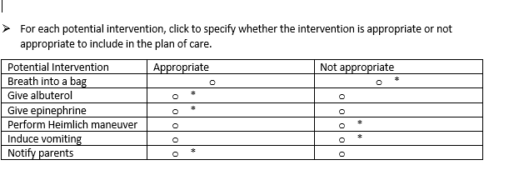
Screen 4 of 6
0/1. This item is worth 6 points. Give yourself 1 point for every row you got correct.

Slide 50
Rationale
Child is not hyperventilating, so loss of CO2 is not a concern requiring breathing into a bag. Albuterol can be used to relieve breathing symptoms. Heimlich maneuver is not indicated as child does not have food lodged in throat. Inducing vomiting is not indicated for situation. Injectable epinephrine should be given, and parents should be notified.

Slide 51
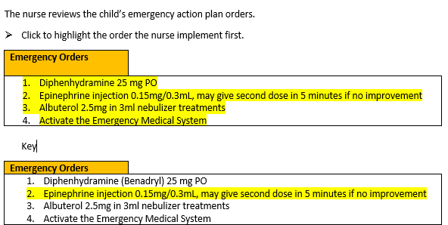
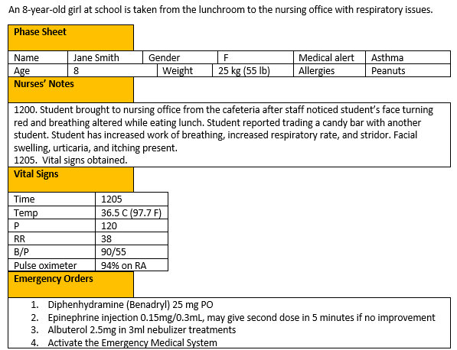
Screen 5 of 6
0/1. This item is worth 1 point. Give yourself 1 point if you got it right.

Slide 52
Rationale
Injectable epinephrine is indicated as first priority due to the student’s immediate condition; child is in anaphylaxis and a PO medication is not indicated. Albuterol may be used but would not be the first priority and activating EMS would happen after the epinephrine is given.

Slide 53
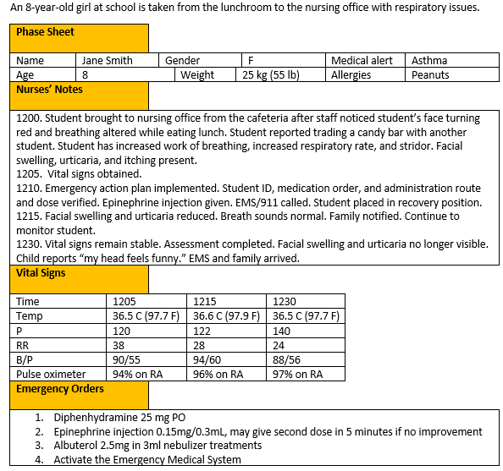
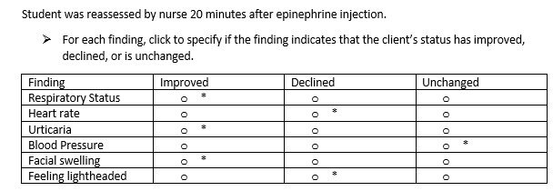
Screen 6 of 6
0/1. This item is worth 6 points. Give yourself 1 point for every row you got right.

Slide 54
Rationale
Reassessment indicates improvement in areas of respiratory status, facial swelling, and itching which is expected with the use of epinephrine. No changes with blood pressure and temperature. Heart rate has increased, and child is reporting symptoms of lightheadedness which both could be a result of the epinephrine.

Slide 55
Case Study 2 Score
Question | Possible | My score
1 | 2
2 | 3
3 | 1
4 | 6
5 | 1
6 | 6
Total | 19

Slide 56
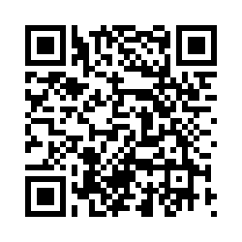
Bowtie # 2
URL
QR Code
https://umaryland.az1.qualtrics.com/jfe/form/SV_eljHHkEaqnMqXH0
Take 2-3 minutes

Slide 57
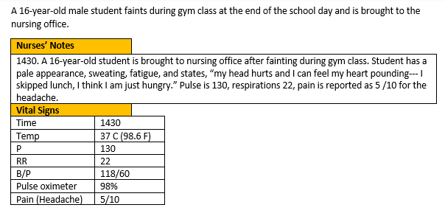
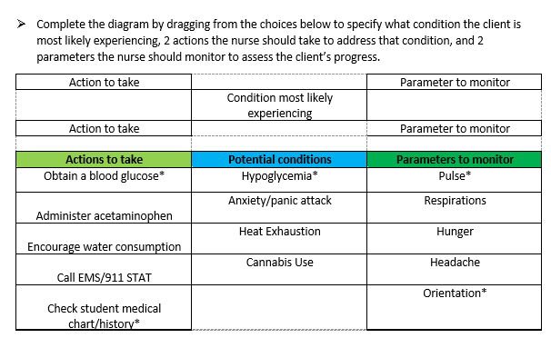
0/1. This item is worth 5 points. Give yourself 1 point for every correct selection.

Slide 58
Rationale
Student has symptoms that relate to hypoglycemia, it would be important to check the student’s history and obtain a blood glucose at this time. Student pulse is elevated and should continue to be monitored and the student is currently speaking and oriented this would need to continue to be monitored to make sure no changes in orientation occur.

Slide 59
Bowtie 2 Score
Question | Possible | My score
Conditions | 1
Actions | 2
Parameters | 2
Total | 5

Slide 60
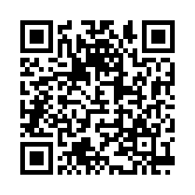
Case Study # 3
URL
QR Code
https://umaryland.az1.qualtrics.com/jfe/form/SV_b8XdQw1VgICi1T0
Take about 10 minutes

Slide 61
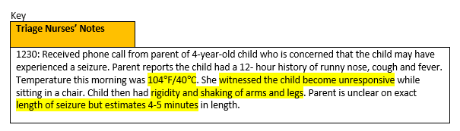
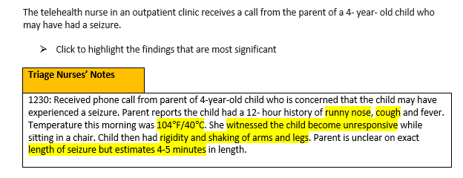
Screen 1 of 6
+/-. This question is worth 4 points.
Give yourself 1 point for each correct phrase you highlighted AND subtract 1 point for each incorrect phrase highlighted. The worst you can score is 0.

Slide 62
Rationale
It is important to note that the child has what appears to be a typical illness, and not other more serious symptoms. The seizure symptoms including unresponsiveness, rigidity and shaking of limbs are typical for tonic- clonic febrile seizure. Seizure length is important to note, seizures longer than 15 minutes are typically recommended for ER transfer.

Slide 63
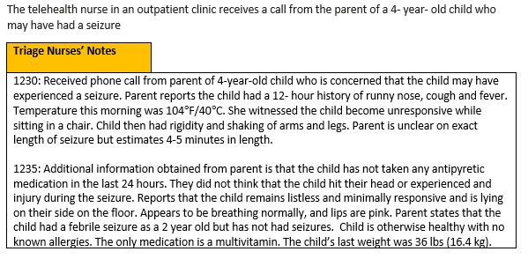
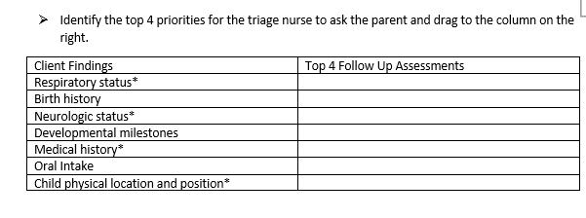
Screen 2 of 6
0/1. This question is worth 4 points.
Give yourself 1 point for every correct option you selected.

Slide 64
Rationale
The nurse needs to identify if the child is in immediate physical or physiologic danger. In a triage setting this is often completed by standard questions. The child’s birth history, intake and output and developmental status are not priorities. The nurse will need to know if the child has any underlying medical conditions or has received any medications recently.

Slide 65
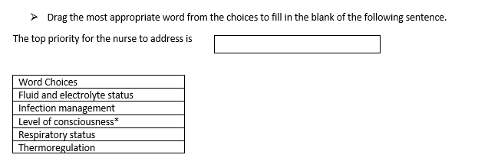
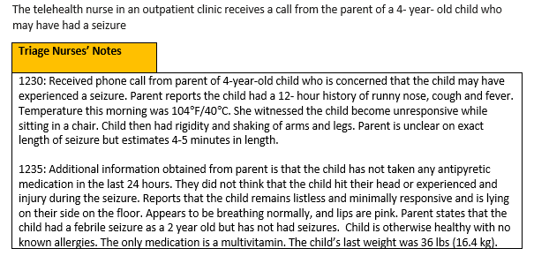
Screen 3 of 6
0/1. This question is worth 1 point.
Give yourself 1 point if you answered correctly.

Slide 66
Rationale
The child’s neurologic status remains impaired. Current respiratory status appears stable, and the infection and intake and output are not the highest priority.

Slide 67
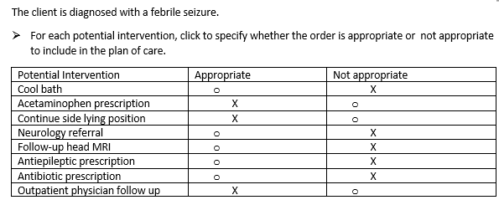
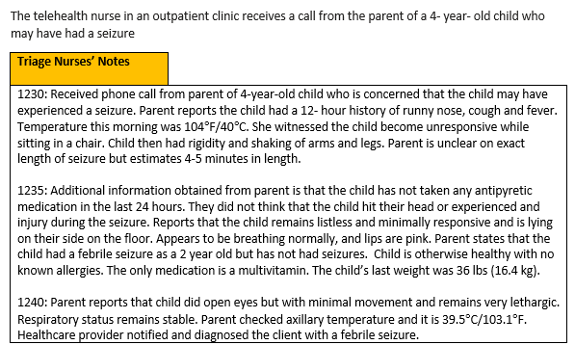
Screen 4 of 6
0/1. This item is worth 8 points. Give yourself 1 point for every row you got correct.

Slide 68
Rationale
It is expected for a child to remain lethargic post seizure. While very lethargic, no oral medications or fluids should be attempted. Fever is best managed with an antipyretic, and rectal route if available is best for the neurologically altered child. A cool bath is never indicated for fever management. At this point, MRI, antiepileptic and antibiotic are not indicated. The nurse should instruct the parent to maintain safe positioning while the child is altered, and schedule to see the physician as soon as possible.

Slide 69
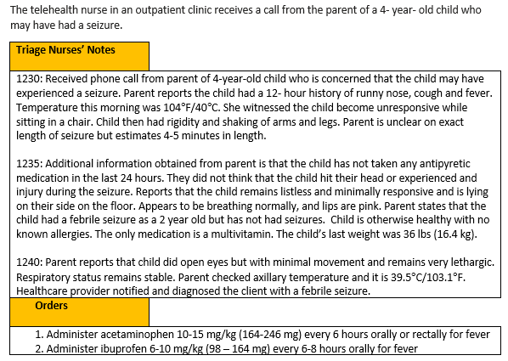
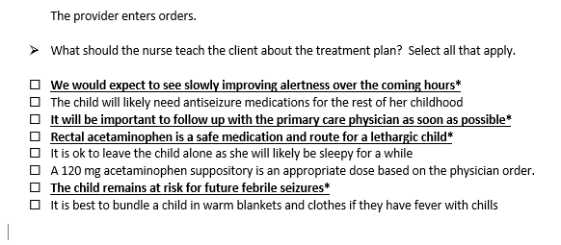
Screen 5 of 6
+/-. This item is worth 4 points. Score 1 point for each correct answer you selected AND subtract 1point for each incorrect answer you picked. The worst you can score is 0.

Slide 70
Rationale
The nurse should convey importance of safety/continued monitoring of the child’s condition, appropriate fever management and follow up as needed. Febrile seizures are not contagious although the underlying illness causing the fever could be contagious. Febrile seizures typically resolve in early childhood and do not require ongoing medical management. 120 mg of acetaminophen is subtherapeutic for the child’s weight.

Slide 71
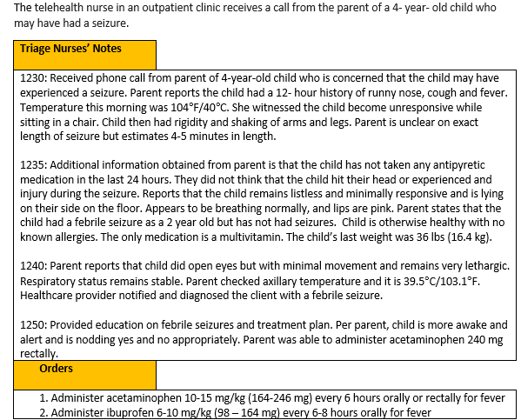
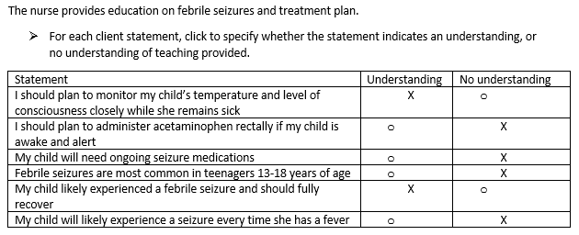
Screen 6 of 6
0/1. This item is worth 6 points. Give yourself 1 point for every row you got right.

Slide 72
Rationale
The child with a febrile seizure may need closer monitoring while ill or potentially febrile as one febrile seizure can be predictive of future febrile seizures. Children typically experience febrile seizures as infants or young children (1-4 years old) and outgrow febrile seizures with no remaining deficits or neurologic issues and do not need chronic antiepileptics. Rectal acetaminophen is not necessary for the child who is able to take oral medications but may be needed for the child who is neurologically impaired or lethargic.

Slide 73
Case Study 3 Score
Question | Possible | My score
1 | 4
2 | 4
3 | 1
4 | 8
5 | 4
6 | 6
Total | 27

Slide 74
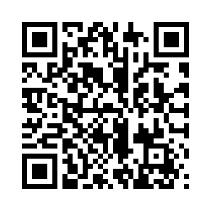
Trend # 1
URL
QR Code
https://umaryland.az1.qualtrics.com/jfe/form/SV_54rWUN5iC91OzYO
Take 2-3 minutes

Slide 75
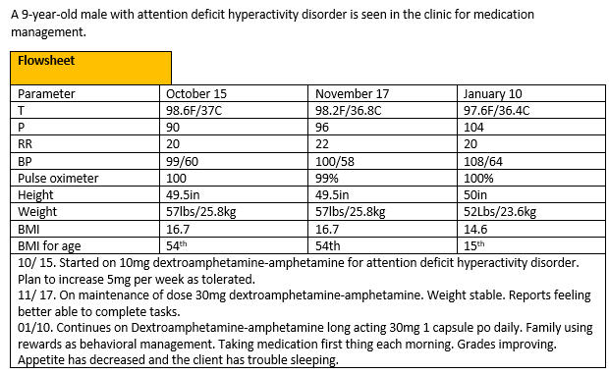

0/1. This item is worth 1 point. Give yourself 1 point if you got it correct.

Slide 76
Rationale
Side effects are predictable unintended responses to medications. For stimulants used to treat attention deficit hyperactivity disorders side effects include decreased appetite, rapid weight loss and insomnia. Side effects can often be managed without discontinuing treatment. Adverse reactions are less predictable, more severe, and more likely to require discontinuing treatment. The client is having a therapeutic effect (improved behavior/school performance) on the target dose thus it is unlikely the effects are due to non- compliance. There is no evidence of drug dependence.

Slide 77
Trend 1 Score
Question | Possible | My score
Points | 1

Slide 78
My Total
Item | Possible Points | My score
Case study 1 | 26
Bowtie 1 | 5
Case study 2 | 19
Bowtie 2 | 5
Case study 3 | 27
Trend 1 | 1
Total Possible | 83

Slide 79

Please Complete the Mini Review Evaluation
https://umaryland.az1.qualtrics.com/jfe/form/SV_1ZYu3gxvlMDziMS
This evaluation will take approximately less than 2 minutes to complete.

